Slide 1
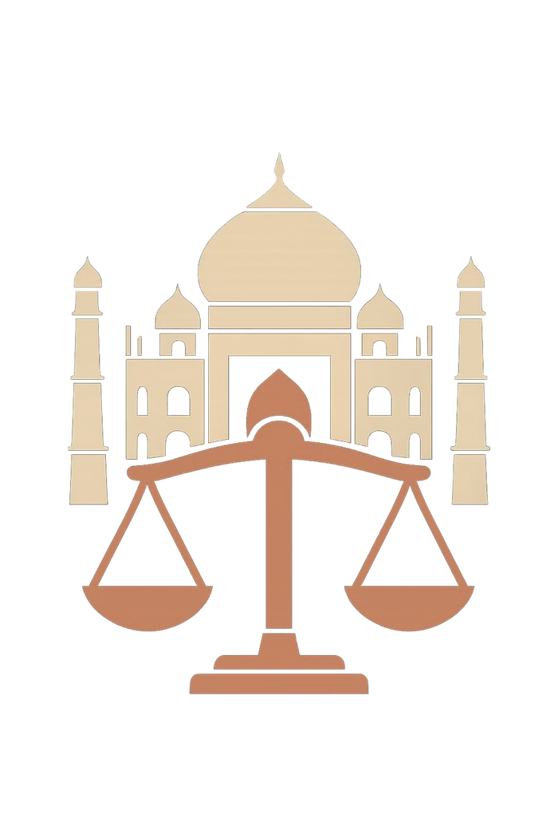

NyaySetu
AI-Powered Legal Companion for India
PRESENTER
Kunal Gupta
Notes:
1

Slide 2
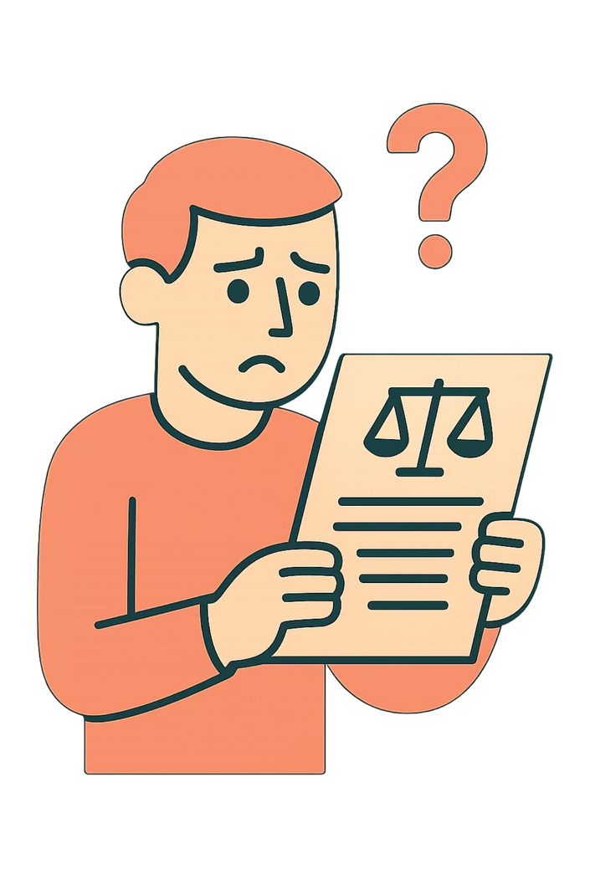
The Problem
Millions of Indians face legal challenges every day — yet the legal system remains out of reach for most. The result: people avoid legal help entirely, or make costly wrong decisions.
💸 Too Expensive
Legal consultations cost thousands of rupees — unaffordable for the average citizen.
🤯 Hard to Understand
Legal language is complex and inaccessible to common people without formal training.
🌐 English Only
Most legal resources exist only in English, excluding hundreds of millions of Indians.
❓ Unaware of Rights
People simply don't know what rights they have or how to exercise them.
👉 Result: People avoid legal help or make wrong decisions — justice becomes a privilege, not a right.
Notes:
2

Slide 3

Our Solution — NyaySetu
NyaySetu is an AI-powered legal assistant that makes legal help easy, accessible, and available in the language every Indian speaks.
AI-Powered Legal Assistant
Legal help becomes easy and accessible — NyaySetu bridges the gap between citizens and the justice they deserve.
Intelligent responses grounded in Indian law, available 24/7 at your fingertips.
Chat-Based Interface
Conversational design that feels natural — no legal jargon, no intimidation.
Multiple Indian Languages
Hindi, Tamil, Bengali, Telugu and more — speak to NyaySetu in your own language.
Simple Rights Explanations
Complex laws broken down into plain, actionable language anyone can understand.
Notes:
3

Slide 4





Key Features
NyaySetu is built with five powerful pillars that together create a complete legal companion for every Indian citizen.
AI Legal Chat
Multilingual Support
Legal Document Generator
Ask any legal question in plain language and receive clear, accurate answers powered by Indian legal data.
Communicate in Hindi, Tamil, Bengali, Telugu, Marathi and more — breaking the English barrier.
Automatically generate legally sound documents like affidavits, notices, and agreements in minutes.
Law Simplifier
Lawyer Referral System
Translates complex legal statutes and sections into simple, everyday language anyone can grasp.
Connect with verified, affordable lawyers nearby when your case needs professional human expertise.
Notes:
4

Slide 5
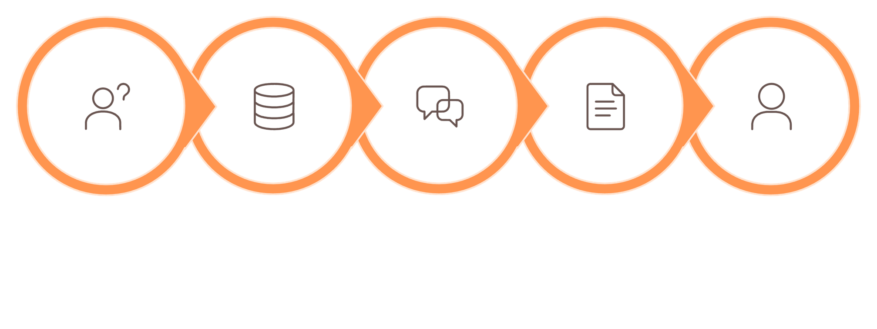





How It Works
From question to resolution — NyaySetu guides every user through a seamless five-step journey to legal clarity.
Ask Question
AI Reviews Law
Plain Answer
Generate Doc
Connect Lawyer
The entire journey — from asking a question to receiving professional legal support — is designed to be intuitive, fast, and available in the user's preferred Indian language.
Notes:
5

Slide 6
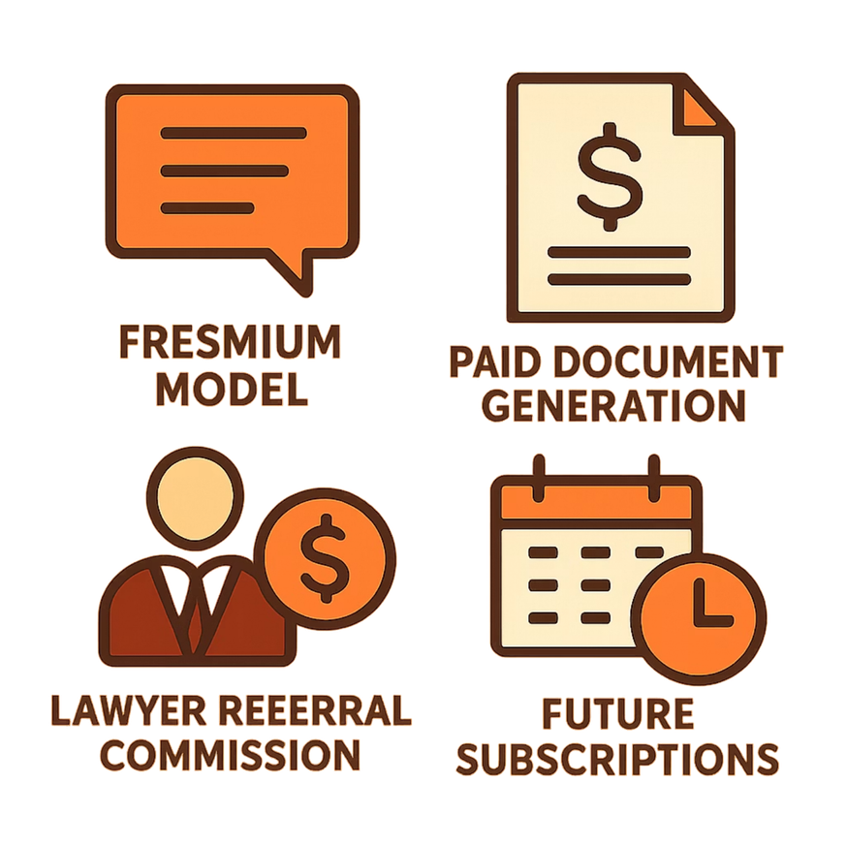

Business Model
NyaySetu is built on a sustainable, scalable revenue model that keeps core access free while monetising premium services — ensuring both social impact and commercial viability.
Freemium Model
Paid Document Generation
Core legal chat is free for all users — driving mass adoption across India.
Users pay a small fee to generate legally valid documents — high value, low cost.
Lawyer Referral Commission
Future: Subscription Plans
NyaySetu earns a commission each time a user is successfully connected with a lawyer.
Monthly and annual plans for individuals, businesses, and NGOs needing regular legal support.
Notes:
6

Slide 7

Our Vision
NyaySetu is more than a product — it is a movement to democratise justice across India.
🇮🇳 Legal Help for Every Indian
From rural villages to urban centres, every citizen deserves access to legal knowledge — regardless of language, income, or education.
⚖️ Bridge the Justice Gap
NyaySetu closes the distance between ordinary people and the justice system — making rights real, not just theoretical.
"Justice complicated is justice avoided — NyaySetu simplifies it."
Notes:
7

